Slide 1
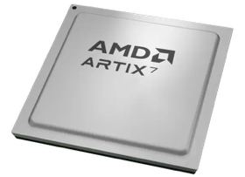
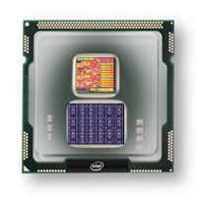
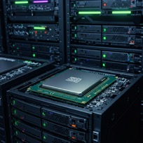
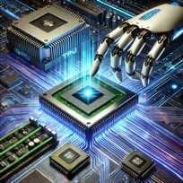
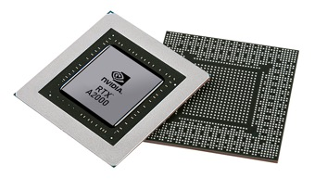


Christof Teuscher
ECE 410/510: Hardware for AI and ML
Neuromorphic chips
Portland State University
Department of Electrical and Computer Engineering (ECE)
www.teuscher-lab.com
teuscher@pdx.edu

Slide 2
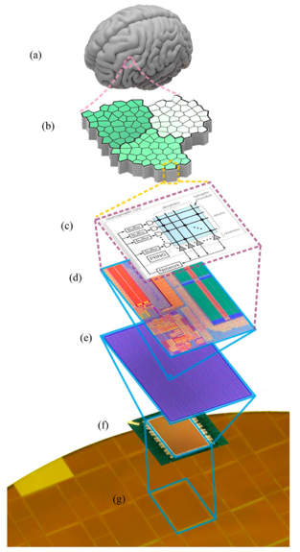
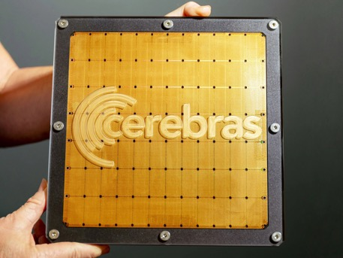
What are neuromorphic chips?
Neuromorphic chips are specialized hardware designed to mimic the structure and function of the human brain. Unlike traditional computing architectures, these chips are built to process information in ways similar to biological neural networks.
Cerebras WSE-3
300-millimeter wafer
4 trillion transistors
TSMC 5nm
57x larger than an NVIDIA H100
Accelerate AI workloads, particularly training and inference of large language models.
Not considered a neuromorphic chip

Slide 3
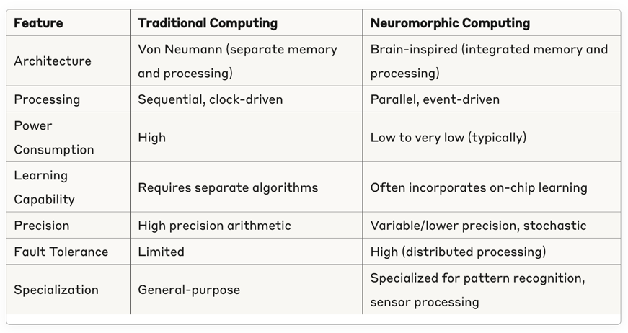
Key characteristics of all neuromorphic chips
Parallel processing - Unlike traditional Von Neumann computing where processing and memory are separate, neuromorphic chips integrate computation and memory in the same physical structures (similar to how brain cells work).
Event-driven computation - Most neuromorphic chips operate based on events or "spikes" rather than continuous clock cycles, making them more energy-efficient by only consuming power when processing information.
Adaptability - Many neuromorphic designs incorporate on-chip learning mechanisms that allow synaptic connections to strengthen or weaken based on activity patterns.
Distributed memory - Information is stored across the network in the connection strengths between neurons, rather than in a centralized memory unit.

Slide 4
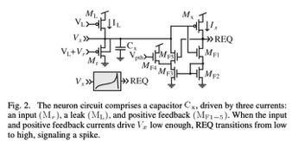
The usual trade-offs…!
Why not do everything in software?
Akida
Loihi
Loihi/2
BrainScaleS/2
T1
SpiNNaker
IBM’s TrueNorth
IBM’s NorthPole
Flexibility
Performance
More digital circuits
Other trade-offs:
Power
Reliability
Programmability
On-chip learning
Cost
Scalability
More analog circuits
But:
Digital backend needed
DAC/ADC
LIF neuron
DOI: 10.1109/TCSI.2010.2089556

Slide 5
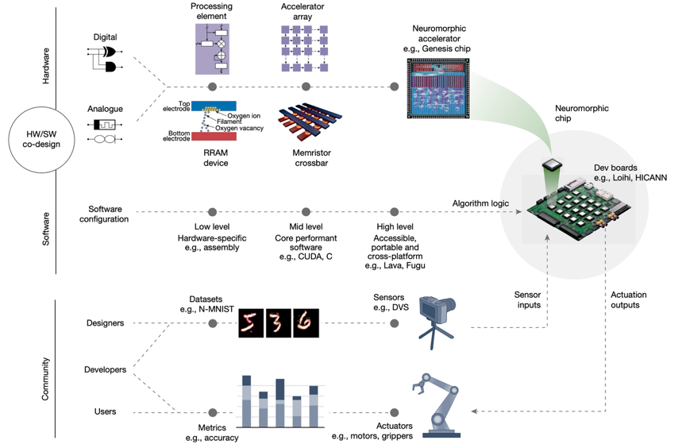
Neuromorphic computing ecosystem
https://doi.org/10.1038/s41586-024-08253-8

Slide 6
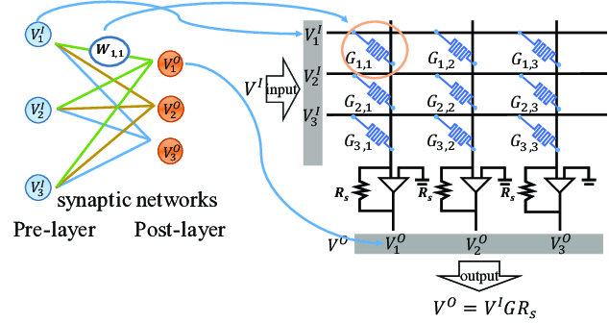
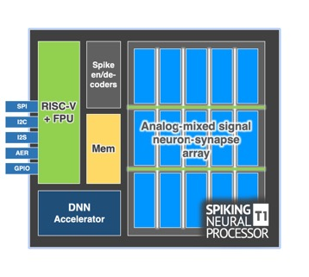
Key building block: the crossbar
Crossbar arrays provide the critical architecture for efficiently implementing synaptic connections between neurons.
Why?
Efficient matrix-vector multiplication
In-memory computing
Implementation of synaptic weights
Parallel processing
Integration with emerging technologies
Generic diagram?

Slide 7
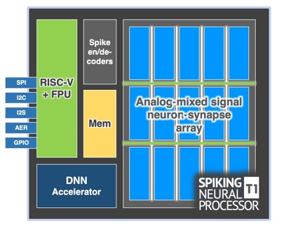
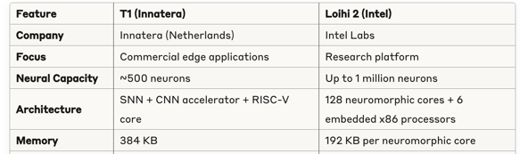
Why a CPU in a neuromorphic processor?
System Management
Network management
Experimentation support
Data management
Conventional processing
T1: The RISC-V core is more integrated into the overall processing pipeline, designed for practical commercial applications where the neuromorphic elements work alongside conventional processing in a unified system.
Loihi 2: The x86 cores are more focused on supporting the neuromorphic research capabilities, providing configuration, monitoring, and data transport services to the neural cores rather than handling general processing tasks.

Slide 8
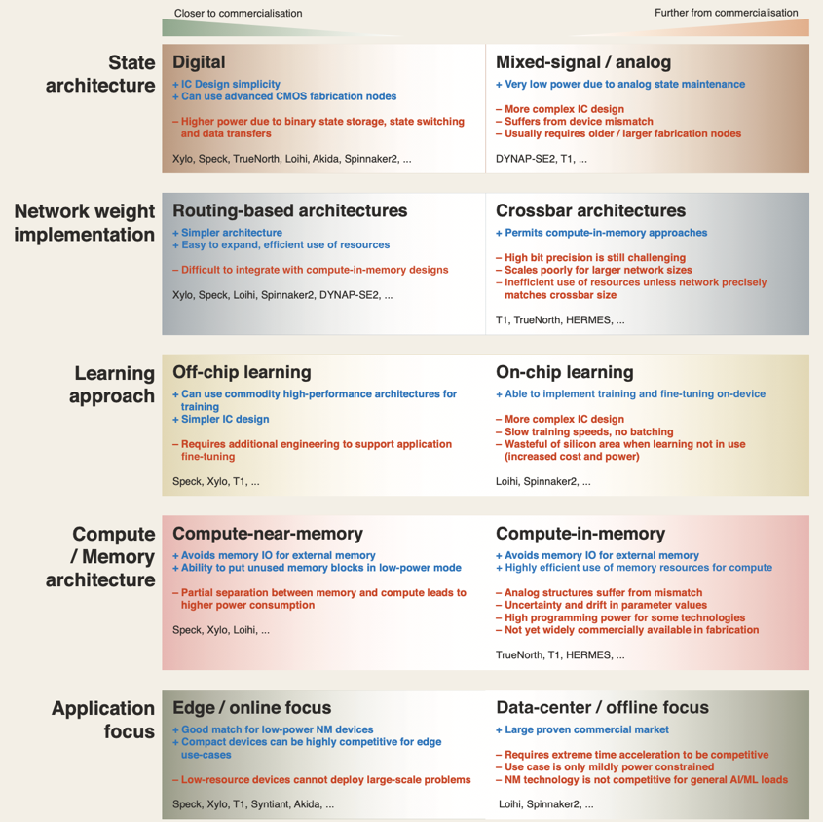
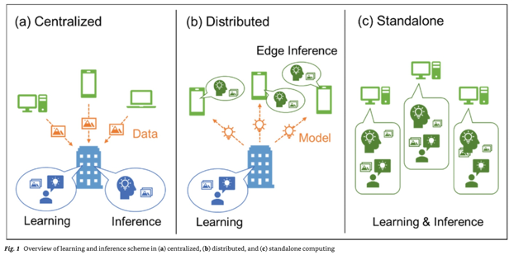
https://doi.org/10.1038/s41467-025-57352-1

Slide 9
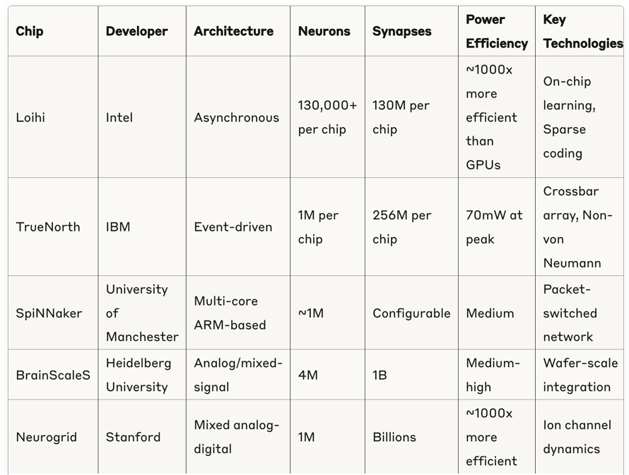
Academic and research chips

Slide 10
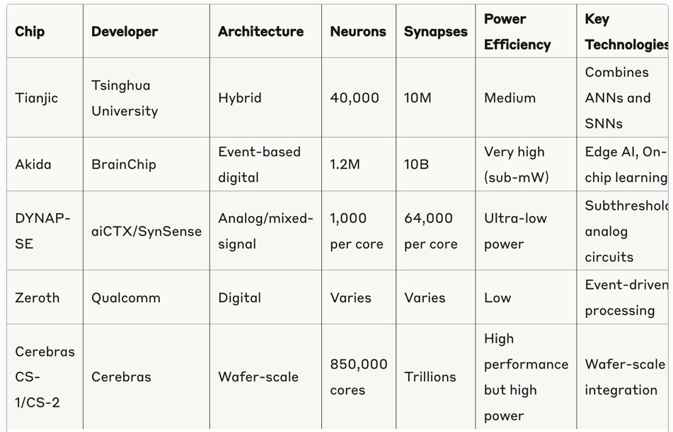
Commercial and emerging neuromorphic chips

Slide 11
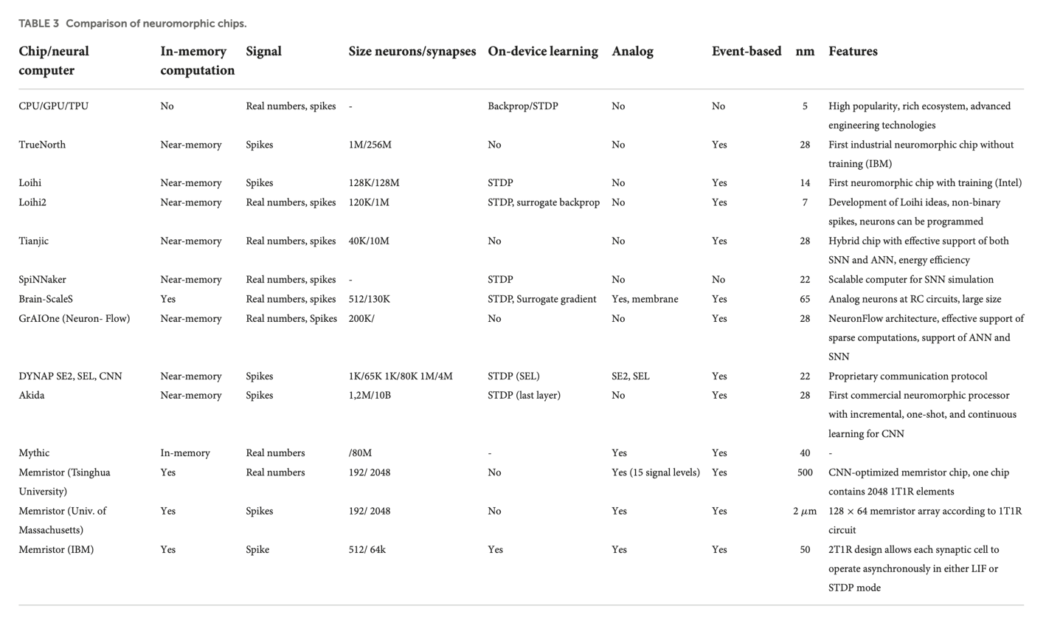
https://doi.org/10.3389/fnins.2022.959626

Slide 12
Current limitations and challenges
Programming Models: Lack of standardized programming frameworks for neuromorphic hardware
Application Development: Limited software ecosystem compared to traditional computing
Scaling: Challenges in scaling to human-brain levels while maintaining efficiency
Algorithm Mapping: Difficulty in mapping existing AI algorithms to neuromorphic architectures
Adoption: Industry adoption still in early stages outside of research applications.
Cost: Silicon cost of large-scale applications is prohibitive. Also: most neuromorphic chips rely on SRAM, which is ~2 orders of magnitude more expensive than DRAM.

Slide 13
Applications
Real-Time Sensing and Processing
Autonomous Vehicles
Edge Computing and IoT
Advanced Robotics
Intelligent Analysis and Security
Cybersecurity
Healthcare Monitoring
Voice and Speech Recognition
Advanced AI Applications
Advanced AI Applications
Efficient Machine Learning
Brain Research
Aerospace and Defense
Autonomous Vehicles
NVIDIA DRIVE AGX provides "a scalable and energy-efficient AI computing platform designed to process the complex workloads required for autonomous driving."
Full Self-Driving (FSD) Computer: Tesla initially used NVIDIA hardware but has since developed its own custom SoC. According to Elon Musk, designing their own chip allows Tesla "to be able to run the neural network at a fundamental, bare metal level" and optimize specifically for their needs. Tesla's FSD computer delivers 144 TOPS while consuming 72 watts of power.
Intel Mobileye EyeQ: BMW, Volkswagen, and Nissan use Mobileye technology.
Qualcomm's Snapdragon Ride: "designed to power all levels of automated driving" with a scalable architecture that can handle everything from basic driver assistance to fully autonomous driving. Volkswagen, BMW, General Motors, and Toyota have partnered with Qualcomm for their autonomous technology

Slide 14
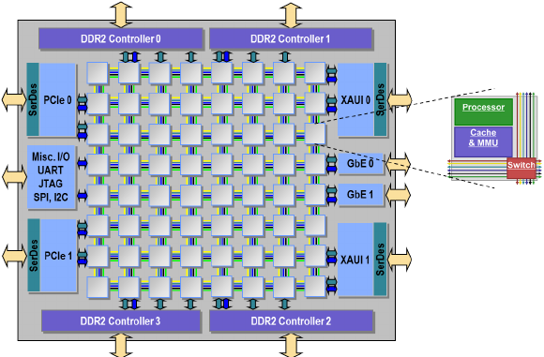
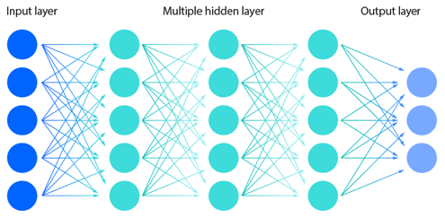
How to communicate spikes?
Not just on-chip, but across multiple chips, boards, servers, etc.
Map on grid of processors

Slide 15
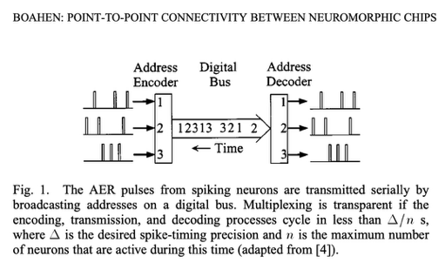
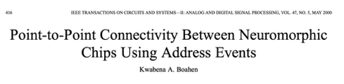
It’s all about AER (Address Event Representation)
Address Event Representation (AER) is a spike event message passing protocol for Network-on-Chip (NoC).
Almost all hardware and software simulation environments use a variant of AER.
The simplest and most efficient implementation of AER sends a firing neuron's unique identification number to all of the nodes containing any of that neuron's targets.
Each spike is typically encoded as a packet containing source/destination information
Only active neurons that produce spikes generate messages.
The timing information is implicit in when the message is sent.
Efficient, event-driven communication system.
AER allows for asynchronous, sparse communication between neuromorphic cores
A NoC routes these spike event messages between different neural processing elements.

Slide 16
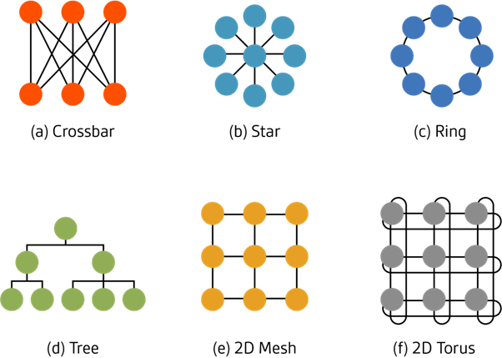
What is a Network-on-Chip (NoC)
A Network-on-Chip (NoC) is a packet-based communication architecture used in large integrated circuits and System-on-Chip (SoC) designs.
A NoC implements networking principles to enable communications between different components of a chip.
In traditional chip designs, components communicate through dedicated point-to-point connections or shared buses. However, as chips became more complex with dozens or hundreds of processing cores, these approaches faced scalability limitations.
NoCs emerged as a solution to these challenges by applying network routing techniques within the chip itself.
https://www.edn.com/network-on-chip-noc-interconnect-topologies-explained

Slide 17
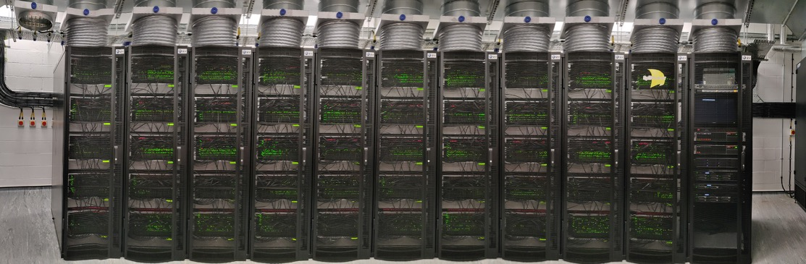
SpiNNaker
SpiNNaker: Contains approximately 1 million ARM9 processor cores across 1,200 boards
SpiNNaker2: Aims for 10 million ARM processor cores, with the current implementation having about 5.2 million cores across 720 boards

Slide 18
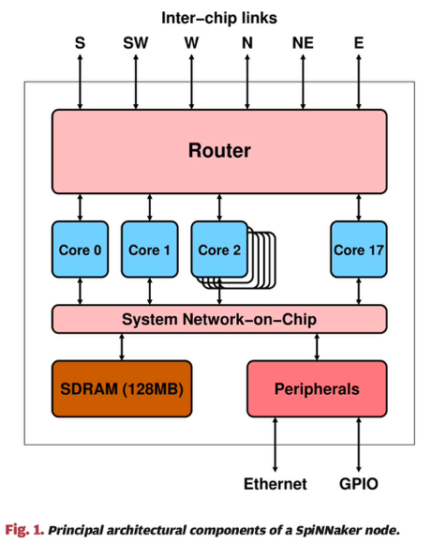
SpiNNaker
The spiking neural network architecture (SpiNNaker) project aims to deliver a massively parallel million-core computer whose interconnect architecture is inspired by the connectivity characteristics of the mammalian brain, and which is suited to the modeling of large-scale spiking neural networks in biological real time.
A SpiNNaker machine is a homogeneous 2D MIMD array of processing nodes. Each node incorporates 18 ARM968 processor cores (1 serves as a spare) each with 96 kB of local memory, 128 MB of shared memory, a packet router, and general system support peripherals.
Each processor core is a general-purpose 200MHz 32-bit integer processor with no floating-point hardware, so arithmetic is generally implemented as fixed point.
DOI: 10.1109/JPROC.2014.2304638

Slide 19
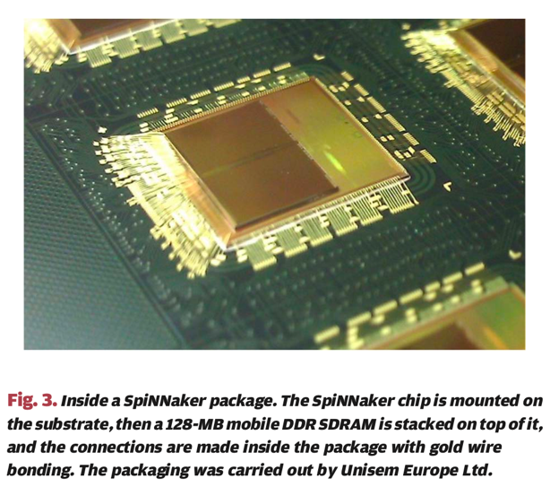
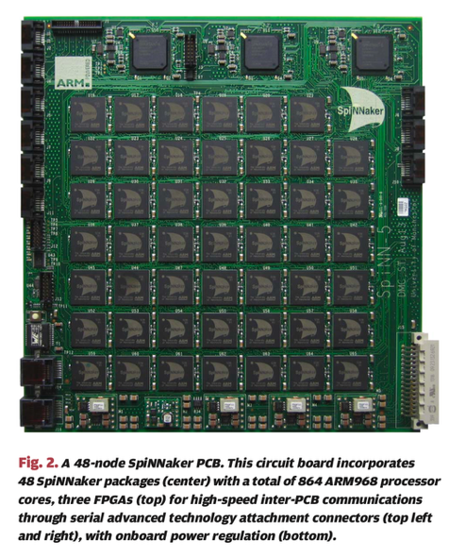
SpiNNaker
DOI: 10.1109/JPROC.2014.2304638

Slide 20
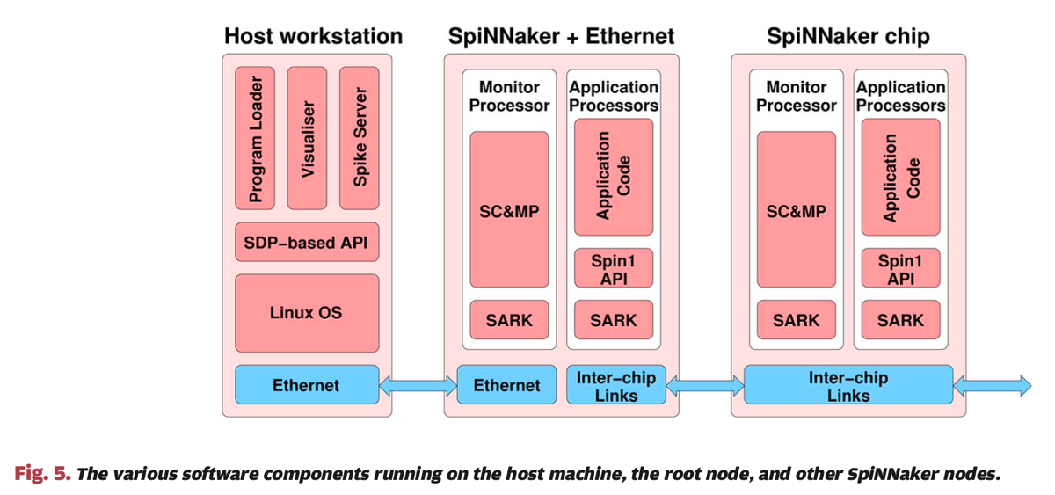
SpiNNaker software
SpiNNaker Control and Monitor Program (SC&MP)
SpiNNaker Application Runtime Kernel (SARK)
The programming model employed on SpiNNaker is that of a real-time event-driven system.
DOI: 10.1109/JPROC.2014.2304638

Slide 21
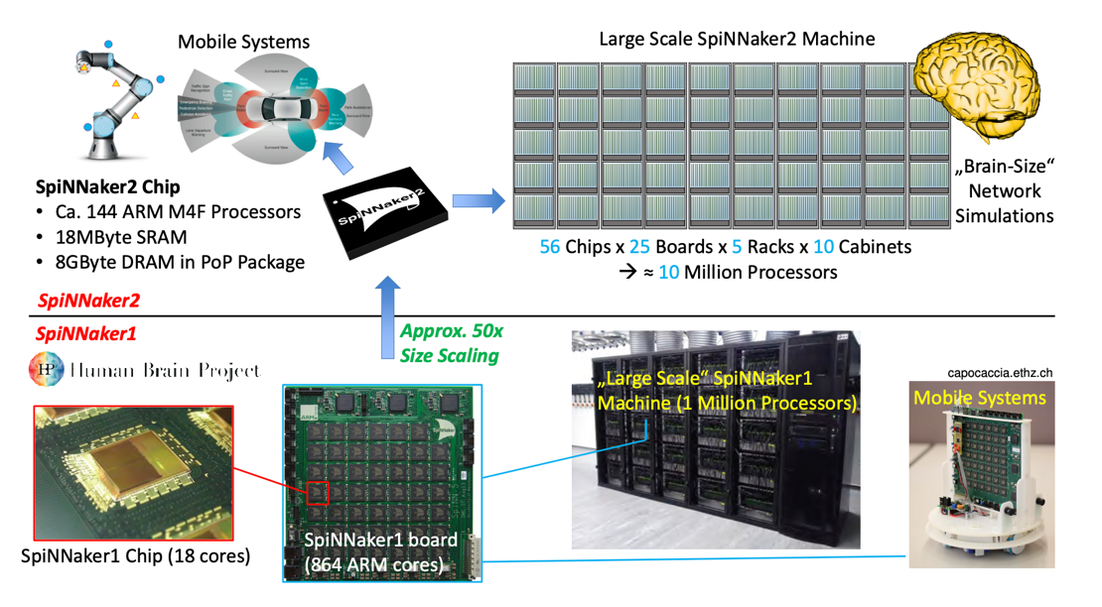
SpiNNaker2
SpiNNaker1: 1 Million core machine in 130nm CMOS
SpiNNaker2: 10 Million core machine in 22nm FDSOI

Slide 22

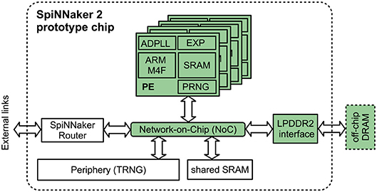
SpiNNaker vs SpiNNaker2
ARM Cortex-M4
ARM9
Pseudo random number generator (PRNG) for stochastic spike integration.

Slide 23
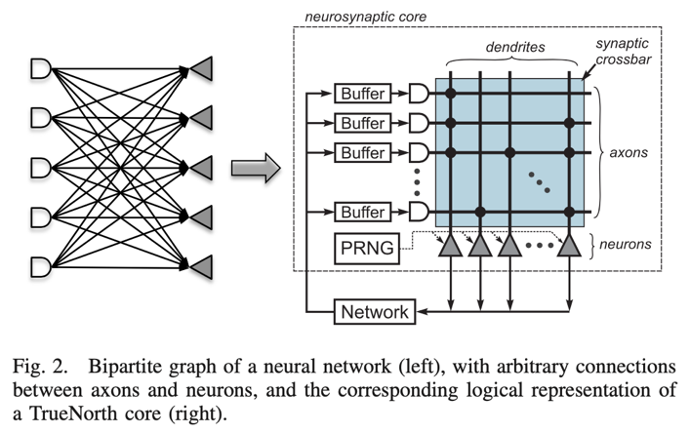
IBM’s TrueNorth
TrueNorth, a 65 mW, 5.4 billion transistor, real-time neurosynaptic processor that implements a non-von Neumann, low-power, highly-parallel, scalable, and defect-tolerant architecture.
With 4096 neurosynaptic cores, the TrueNorth chip contains 1 million digital neurons and 256 million synapses tightly interconnected by an event-driven routing infrastructure.
DOI: 10.1109/TCAD.2015.2474396

Slide 24
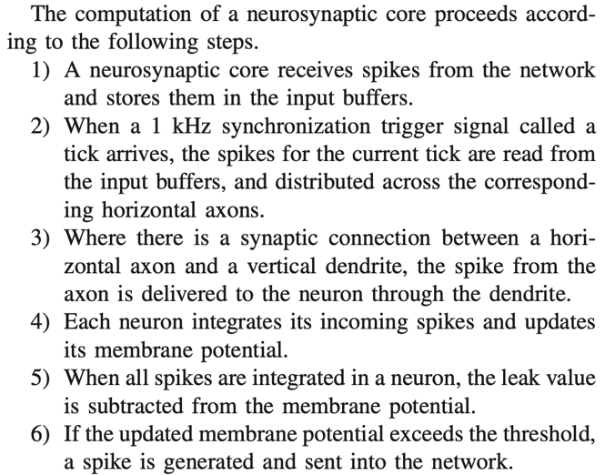

IBM’s TrueNorth
Pseudo random number generator (PRNG) for stochastic spike integration.
DOI: 10.1109/TCAD.2015.2474396

Slide 25
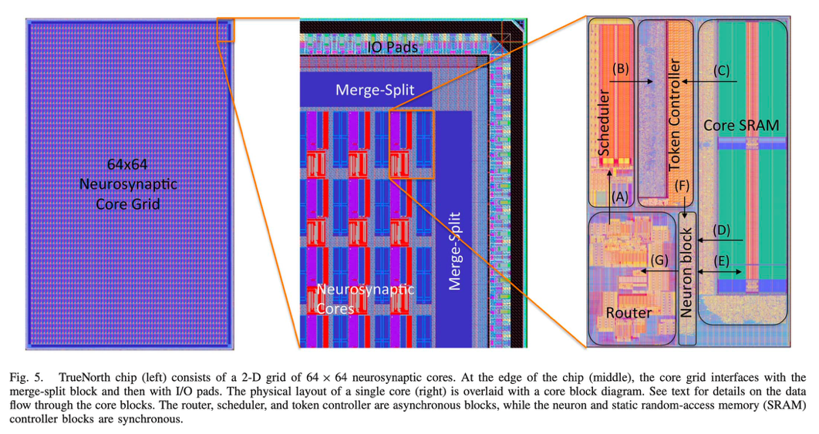
IBM’s TrueNorth chip design
Merge-split blocks at the edges of the chip merge spikes coming from
multiple buses into a single stream of spikes going out of the
chip
DOI: 10.1109/TCAD.2015.2474396

Slide 26
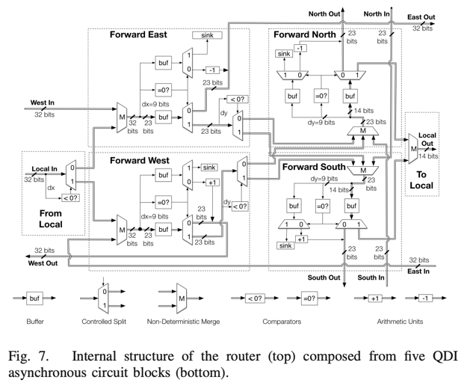
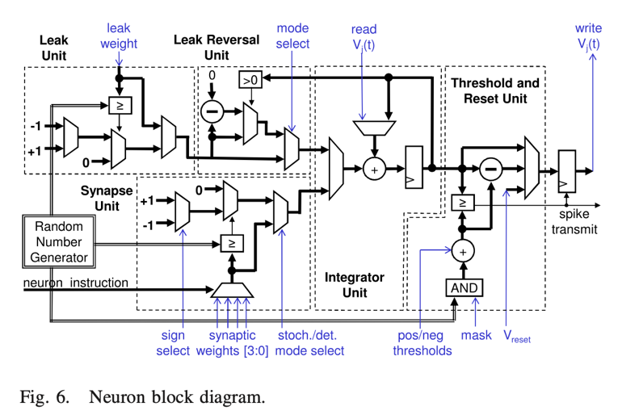
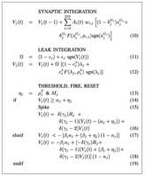
IBM’s TrueNorth
Augmented integrate-and-fire model
2D mesh
6 processes: from local, forward E, forward W, forward N, forward S, to local
5 major elements of the neuron block
Augmented integrate-and-fire model (simpler than HH or Izh)
QDI (Quasi-Delay-Insensitive) async. circuits: handshaking
DOI: 10.1109/TCAD.2015.2474396

Slide 27
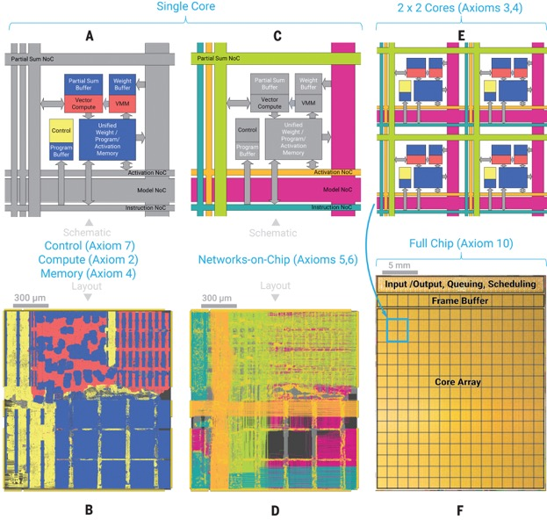
IBM’s NorthPole
NorthPole, an architecture and a programming model for neural inference, reimagines the interaction between compute and memory by embodying 10 interrelated, synergistic axioms that build on brain-inspired computing.
Axiom 1: Turning to architecture, NorthPole is specialized for neural inference. For example, it has no data-dependent conditional branching, and it does not support training or scientific computation.
Axiom 2: Inspired by biological precision, NorthPole is optimized for 8-, 4-, and 2-bit low-precision. This is sufficient to achieve state-of-the-art inference accuracy on many neural networks while dispensing with the high-precision required for training.
Axiom 3: NorthPole has a distributed, modular core array (16-by-16), with each core capable of massive parallelism (8192 2-bit operations per cycle) (Fig. 2F). Cortex-like modularity of the tiled core array enables homogeneous scalability in two dimensions and, perhaps, even in three dimensions and is also amenable to heterogeneous chiplet integration.
Fig 2
https://www.science.org/doi/10.1126/science.adh1174

Slide 28
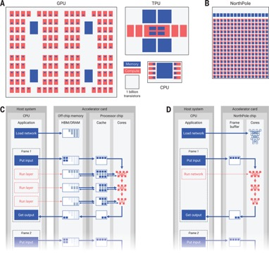
IBM’s NorthPole
Axiom 4: NorthPole distributes memory among cores (Figs. 1B and 2F) and, within a core, not only places memories near compute but also intertwines critical compute with memory (Fig. 2, A and B). The nearness of memory and compute enables each core to exploit data locality for energy efficiency. NorthPole dedicates a large area to on-chip memory that is neither centralized nor organized in a traditional memory hierarchy.
Fig 2
Fig 1
https://www.science.org/doi/10.1126/science.adh1174

Slide 29
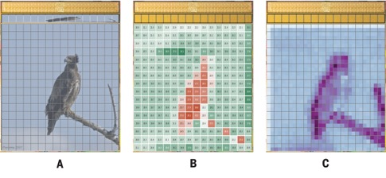
IBM’s NorthPole
Axiom 5: NorthPole uses two dense networks-on-chip (NoCs) (20) to interconnect the cores, unifying and integrating the distributed computation and memory (Fig. 2, C and D) that would otherwise be fragmented. These NoCs are inspired by long-distance white-matter and short-distance gray-matter pathways in the brain and by neuroanatomical topological maps found in cortical sensory and motor systems. One gray matter–inspired NoC enables spatial computing between adjacent cores (Fig. 3 and fig. S1). Another white matter–inspired NoC enables neuron activations to be spatially redistributed among all cores.
Fig 3
Fig 2
https://www.science.org/doi/10.1126/science.adh1174

Slide 30
IBM’s NorthPole
Axiom 6: Another two NoCs enable reconfiguring synaptic weights and programs on each core for high-speed operation of compute units (Fig. 2, C and D).
Axiom 7: NorthPole exploits data-independent branching to support a fully pipelined, stall-free, deterministic control operation for high temporal utilization without any memory misses, which are a hallmark of the von Neumann architecture. Lack of memory misses eliminates the need for speculative, nondeterministic execution. Deterministic operation enables a set of eight threads for various compute, memory, and communication operations to be synchronized by construction and to operate at a high utilization.
Fig 2
https://www.science.org/doi/10.1126/science.adh1174

Slide 31
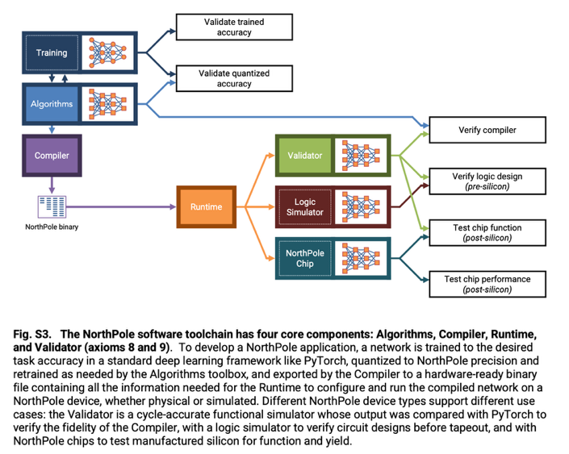
IBM’s NorthPole
Axiom 8: Turning to algorithms and software, co-optimized training algorithms (fig. S3) enable state-of-the-art inference accuracy to be achieved by incorporating low-precision constraints into training.
Axiom 9: Codesigned software (fig. S3) automatically determines an explicit orchestration schedule for computation, memory, and communication to achieve high compute utilization in space and time while ensuring that there are no resource collisions.
Axiom 10: NorthPole employs a usage model that consists of writing an input frame and reading an output frame (Figs. 1D and 3), which enables it to operate independently of the attached general processor.
https://www.science.org/doi/10.1126/science.adh1174

Slide 32
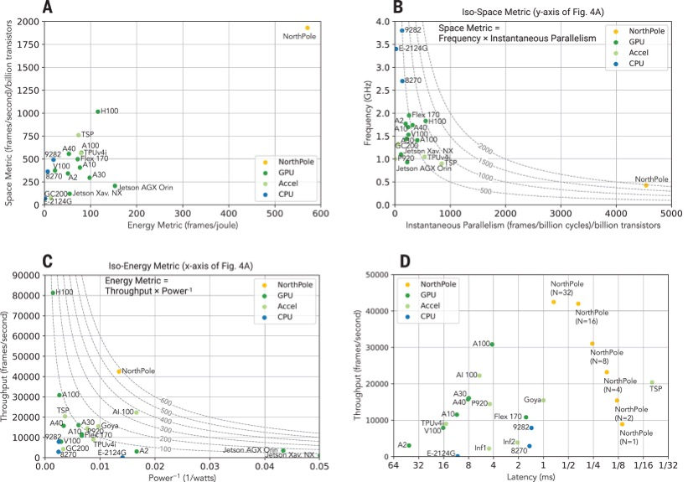
IBM’s NorthPole
Tensor Streaming Processor (TSP)
Intel Xeon: 8270, 9282
https://www.science.org/doi/10.1126/science.adh1174

Slide 33
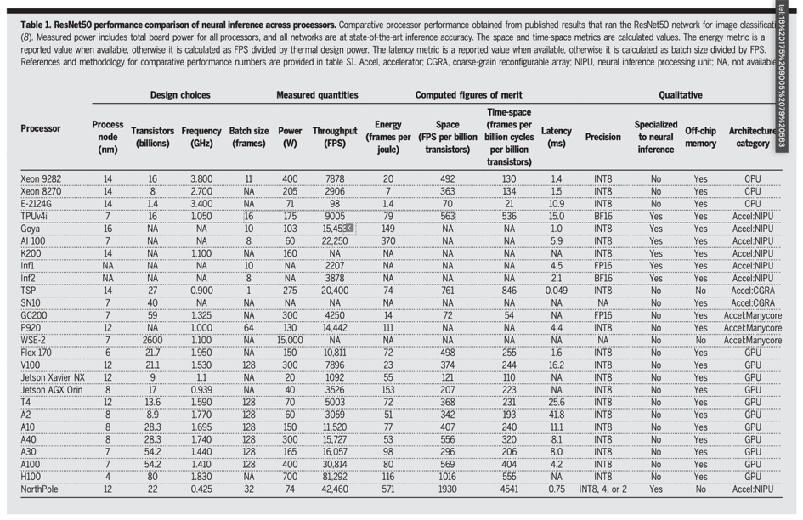
IBM’s NorthPole
https://www.science.org/doi/10.1126/science.adh1174

Slide 34
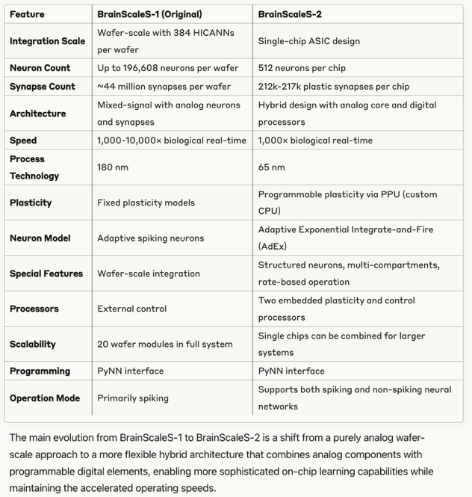
BrainScaleS chips
Heidelberg University
Human Brain Project
Analog model of a neuron based on an electrical circuit, leads to inflexibility.
arXiv:2201.11063v2

Slide 35
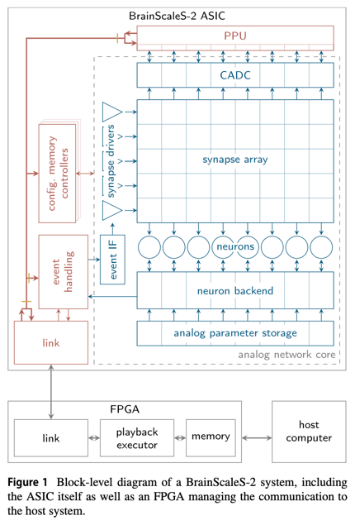
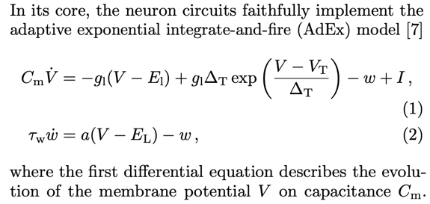
BrainScaleS-2
PPU = plasticity processing unit
arXiv:2201.11063v2

Slide 36
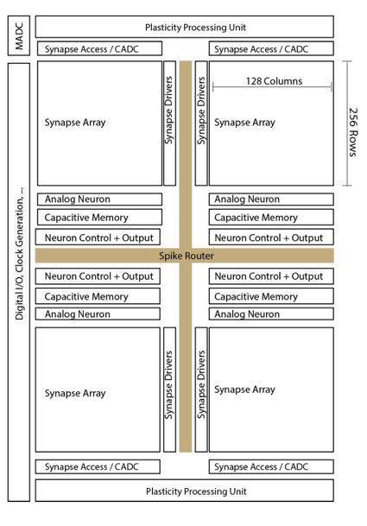
BrainScaleS-2
A single neuromorphic BrainScaleS-2 core consists of a full-custom analog core combining a synaptic crossbar, neuron circuits, analog parameter storage, two digital control- and plasticity-processors, and the event routing network responsible for spike communication.
The physical design is divided into four quadrants, each featuring a synaptic crossbar with 256 rows and 128 columns. The neuron circuitry is also partitioned in this way, with each of the 512 neuron circuits associated with one column.
arXiv:2201.11063v2

Slide 37
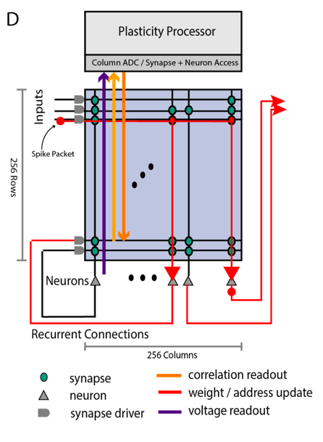
BrainScaleS-2
Conceptual view of the system architecture in spike processing mode: Event packets (red dot) get injected by the synapse driver into the synaptic crossbar, where they cause synaptic input integration to occur in synapses with matching addresses (indicated by red lines). Membrane voltage accumulation eventually results in spike generation in the associated neuron circuits. The resulting spikes are routable to both synapse drivers or external output. The plasticity processing unit has low latency and massively parallel access to synaptic weights, addresses, correlation measurements, and neuron membrane voltage dynamics during operation. Plasticity rules and other learning algorithms can use these observables to modify all parameters determining network emulation in an online fashion.
arXiv:2201.11063v2

Slide 38
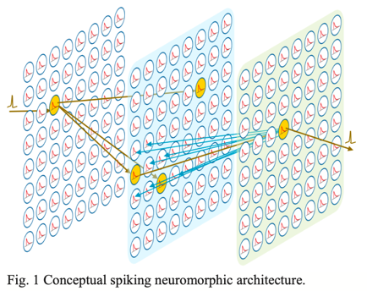
Loihi
Loihi is a 60-mm² chip fabricated in Intel’s 14-nm process that advances the state-of-the-art modeling of spiking neural networks in silicon.
Fully digital, but asynchronous
An unambiguous example of spike-based computation, outperforming all known conventional solutions.
Excellent energy efficiency arises from the architecture’s sparse activation with tightly spatially scoped communication. With its specialized asynchronous implementation, Loihi can update many millions of such neurons in microseconds, allowing it to propagate critical events, such as the spike shown in Fig. 1, in a fraction of the time a conventional CPU needs to sequentially inspect and update just one iteration of neural state variables in memory.
M. Davis, Lessons from Loihi: Progress in Neuromorphic Computing

Slide 39
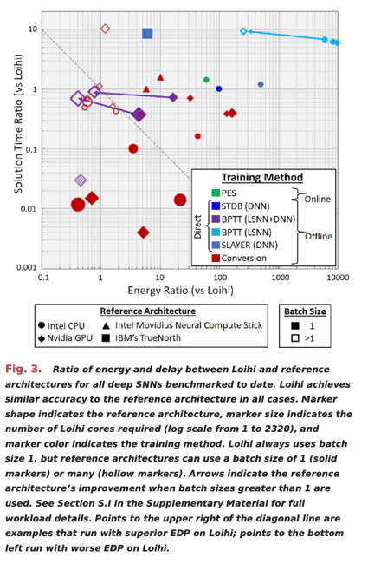

Loihi
However: neuromorphic HW is not in general competitive with general AI/ML workloads.
M. Davis, Lessons from Loihi: Progress in Neuromorphic Computing
Energy-delay product (EDP)
https://ieeexplore.ieee.org/document/9395703

Slide 40
Loihi computational primitives
Loihi includes several computational primitives related to other active areas of SNN algorithmic research:
Stochastic noise. Uniformly distributed pseudorandom numbers might be added to a neuron’s synaptic response current, membrane voltage, and refractory delay. This provides support for algorithms such as Neural Sampling, which can solve probabilistic inference and constraint satisfaction problems using stochastic dynamics and a form of Markov chain Monte Carlo sampling.
Configurable and adaptable synaptic, axon, and refractory delays. This provides support for novel forms of temporal computation such as polychronous dynamics,10 in which subsets of neurons might synchronize over periods of varying timescales. The number of polychronous groups far exceeds the number of stable attractors in conventional attractor networks, suggesting a productive space for computational development.
Configurable dendritic tree processing. Neurons in the SNN might be decomposed into a tree of compartment units, with the neuron’s input synapses distributed over those compartments. Each compartment supports the same state variables as a neuron, but only the root of the tree (soma compartment) generates spike outputs. The compartments’ state variables are combined in a configurable manner by programming different join functions for each compartment junction.
Neuron threshold adaptation in support of intrinsic excitability homeostasis.
Scaling and saturation of synaptic weights in support of “permanence” levels that exceed the range of weights used during inference.
Intrinsic excitability homeostasis refers to a neuron's ability to maintain its excitability levels within an appropriate range through changes in its own intrinsic properties
DOI: 10.1109/MM.2018.112130359

Slide 41

Loihi
Reconfigurable learning engine
DOI: 10.1109/MM.2018.112130359

Slide 42


Loihi
DOI: 10.1109/MM.2018.112130359

Slide 43




Slide 44

Loihi 2 + Hala Point
https://www.youtube.com/watch?v=CPuaud9xi3U

Slide 45




Loihi 2
DOI 10.1109/SiPS52927.2021.00053

Slide 46


LLM on Loihi 2
Why is that gain performance not impressive?
arXiv:2503.18002v2

Slide 47

Akida
Akida (Vanarse et al., 2019) is the first commercial neuromorphic processor, commercially available since August 2021.
BrainChip's Akida is an ultra-low-power neuromorphic processor inspired by the brain’s neural architecture. It accelerates complex AI at the edge through event-based processing, on-chip learning abilities, and support form advanced neural networks like CNNs, RNNs & custom Temporal Event-based Nets.
Temporal Event-based Neural Networks (TENNs), which combine spatial and temporal convolutions to efficiently process sequential spatiotemporal data.
Akida’s ecosystem provides a free chip emulator, TensorFlow compatible framework MetaTF for the transformation of convolutional and fully connected neural networks into SNN, and a set of pre-trained models.

Slide 48

Do we need brain-like HW?
“Although efforts to address neuromorphic solutions through hardware based on top-down CMOS-based technologies have obtained interesting results in terms of energetic efficiency improvement, the replication of brain’s self-assembled and redundant architectures
is not considered in the roadmaps of data processing electronics.”
DOI: 10.3389/fnins.2024.1465789

Slide 49

https://doi.org/10.1038/s41467-025-57352-1

Slide 50


https://doi.org/10.1038/s41586-024-08253-8

Slide 51

Progression of neuromorphic computing systems
https://doi.org/10.1038/s41586-024-08253-8

Slide 52

Feature maturation of neuromorphic computing
https://doi.org/10.1038/s41586-024-08253-8

Slide 53

Gaps in neuromorphic computing
https://doi.org/10.1038/s41586-024-08253-8

Slide 54


Are spikes the future for LLMs?
SNN can’t be trained with backpropagation. STDP is used instead.
Local learning only
Credit assignment problem
Lack of scalability and efficiency
Lack of global optimization objective
No mathematical convergence guarantee
Transformers are inherently un-brain–like.
The attention mechanism requires matrix-matrix multiplication. Hard to implement in neuromorphic architectures.

Slide 55
Recap: neuromorphic chip design choices
Spikes vs analog
Stochastic vs reduced precision vs full precision
In-memory vs near-memory vs von Neumann
NoC vs shared bus vs wires
Inference and/or learning
Crossbar vs non-crossbar
Neuron circuitry vs configurable neuron vs programmable neuron
STDP vs backprop vs other learning rules
Embedded vs datacenter
Number of neurons vs complexity of neuron and/or learning rate
Amount of memory

